Slide 1


What Does BERT Look At? An Analysis of BERT’s Attention - Paper Review
Education:
M.S. in Electrical and Computer Engineering, 2020
Research Interests:
Multimodal Machine Learning
Deep Learning
Applied Machine Learning
Abhishek Das
Website: https://abhishek0697.github.io/
Email: addas@andrew.cmu.edu

Slide 2
What Does BERT Look At? An Analysis of BERT’s Attention
Kevin Clark¹, Urvashi Khandelwal¹, Christopher D. Manning¹, Omer Levy²
¹Stanford University, ²Facebook AI Research
Paper Review
Main contributions/ findings
Background and Conventions
Surface – Level Patterns in Attention
Probing Attention Heads
Clustering Attention Heads
Analysis on Toy Dataset:
Heads showing interesting relations on a sample dataset
Head Clustering plots

Slide 3
Main Contributions/ Findings-
1. Demonstrate what aspects of language do large-pretrained networks learn from unlabeled data.
2. Propose methods for understanding the attention mechanisms of pre-trained models.
3. BERT’s attention heads exhibit patterns such as:
Attending to delimiter tokens,
Specific positional offsets,
Broadly attending over the whole sentence
Heads in the same layer often exhibiting similar behaviors.
4. Find heads specializing in attending to syntactic dependencies like direct objects of verbs, determiners of nouns, objects of prepositions, and coreferent mentions with remarkably high accuracy.

Slide 4
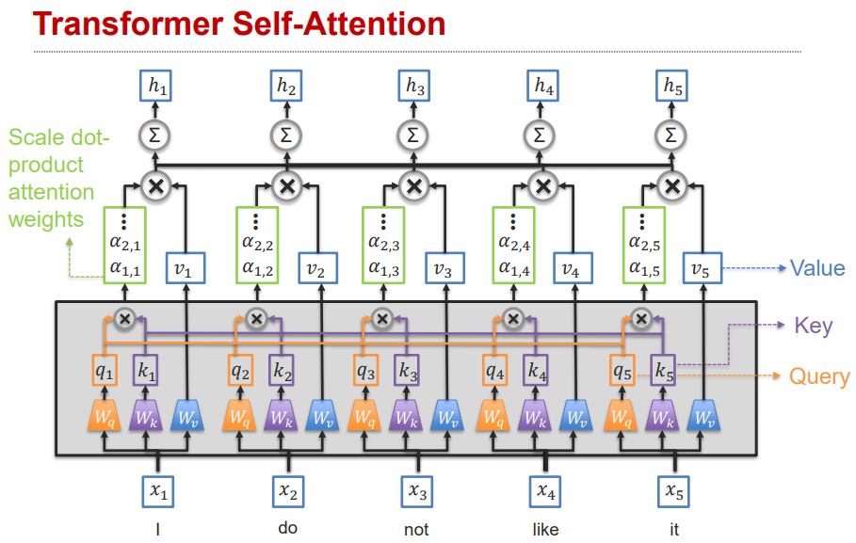
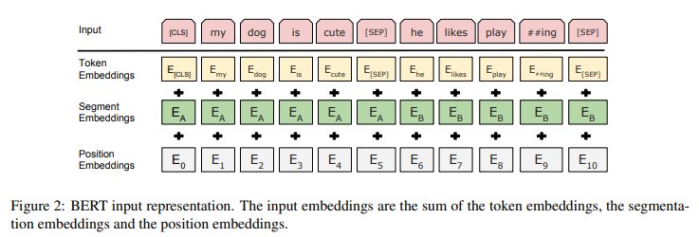

Some Background about BERT and conventions followed in this paper:
BERT - Bidirectional Encoder Representations from Transformers.
Pre-trained on 3.3 billion tokens of English text to perform two tasks, namely Masked language modeling and Next Sentence prediction.
Model used in this paper: ”base-sized” BERT,
It has 12 Transformer layers, with 12 attention heads each.
A specific attention head is referred as ‘’layer_head’’.
[CLS] token at start of sentence
[SEP] token after each sentence
* Figure referred from original BERT paper
**Figure referred from 11-777 Multimodal ML course lecture at CMU

Slide 5
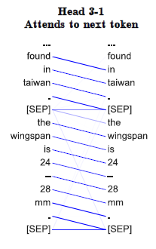
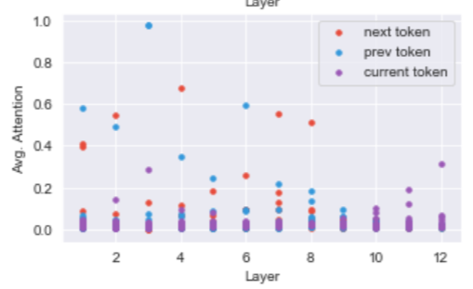
Setup for Analysis:
Extract the attention maps from BERT-base over 1000 random Wikipedia segments
Surface-Level Patterns in Attention:
3.1 Relative Position
Most heads put little attention on the current token.
In earlier layers of the network, there are heads that attend heavily on the next or previous token.
Four heads (in layers 2, 4, 7, and 8) on average put >50% of their attention on the previous token.
Five heads (in layers 1, 2, 2, 3, and 6) put >50% of their attention on the next token.
Average attention a BERT head puts on a specific type of token

Slide 6
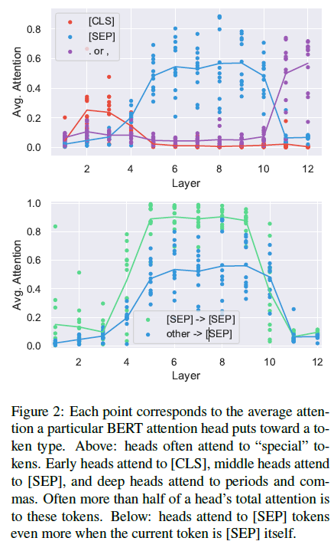
Surface-Level Patterns in Attention
3.2 Attending to Separator Tokens
over half of BERT’s attention in layers 6-10 focuses on [SEP].
Possible explanations:
High probability of occurrence of these tokens.
i.e. [SEP] and [CLS] are guaranteed to be present in a segment and are never masked out.

Slide 7
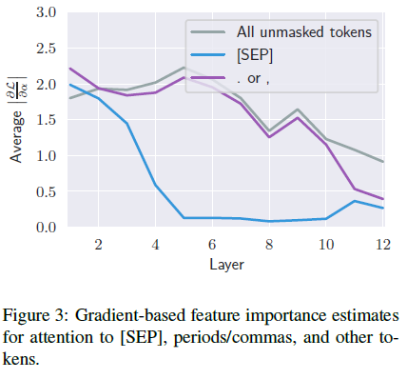
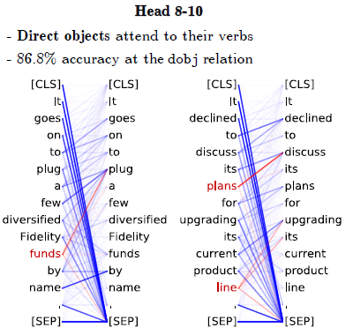
3.2 Attending to Separator Tokens
Compute the magnitude of the gradient of the loss from BERT’s MLM task with respect to each attention weight.
Hypothesis - Heads with specific functions attend to [SEP] when the function is not called for.
Starting in layer 5 – the same layer where attention to [SEP] becomes high– the gradients for attention to [SEP] become very small. This indicates that attending to [SEP] does not substantially change BERT’s outputs.
This supports the theory that attention to [SEP] is used as a no-op for attention heads.
For e.g. In head 8-10, direct objects attend to their verbs. For this head, non-nouns mostly attend to [SEP].

Slide 8
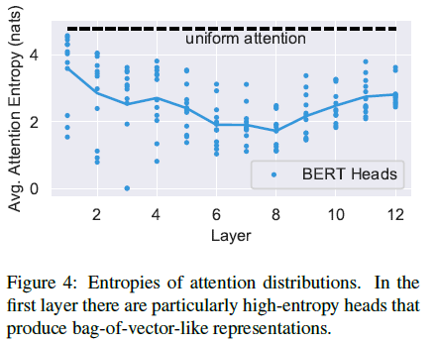
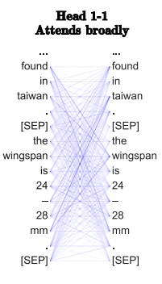
Surface-Level Patterns in Attention
3.3 Focused vs Broad Attention
Findings:
Some attention heads, especially in lower layers, have very broad attention (high-entropy).
High-entropy heads typically spend at most 10% of their attention mass on any single word.
Formula:
entropies -= (attns * np.log(attns)).sum(-1).mean(-1)

Slide 9
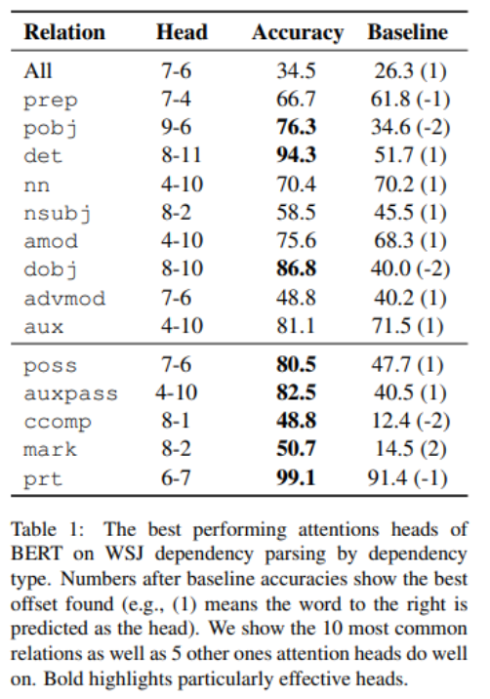
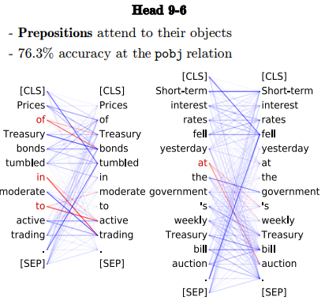
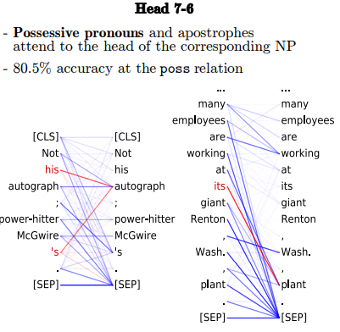
Probing Individual Attention Heads on Dependency Syntax
Setup for Analysis:
Extract the attention maps from BERT-base on WSJ portion of Penn Tree-Bank annotated with Stanford Dependencies
Handling words which split into multiple tokens- for e.g., ‘playing’ split into ‘play’ and ‘##ing’
For attention to a split-up word, the attention weights are summed over its tokens.
For attention from a split-up word, take the mean of the attention weights over its tokens.
Examples of heads that learn syntax-sensitive behavior
There is no single head that does well for all syntax-relations.

Slide 10

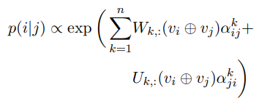
Probing Attention Head Combinations
Individual attention heads specialize to particular aspects of syntax
Goal: Measure overall ability using attention-based probing classifiers
Given an input word, the classifier produces a probability distribution over other words in the sentence indicating how likely each other word is to be the syntactic head of the current one.
Attention-Only Probe
Attention-and-Words Probe
Use GloVe embeddings to produce word sensitive weights for an attention head
Learn a simple linear combination of weights
p(i|j) is the probability of word i being word j’s syntactic head
w and u are learned
where,
v: GloVe embeddings (held fixed)
⊕: concatenation
W and U are learned
Outperforms other baselines with UAS score of 77

Slide 11
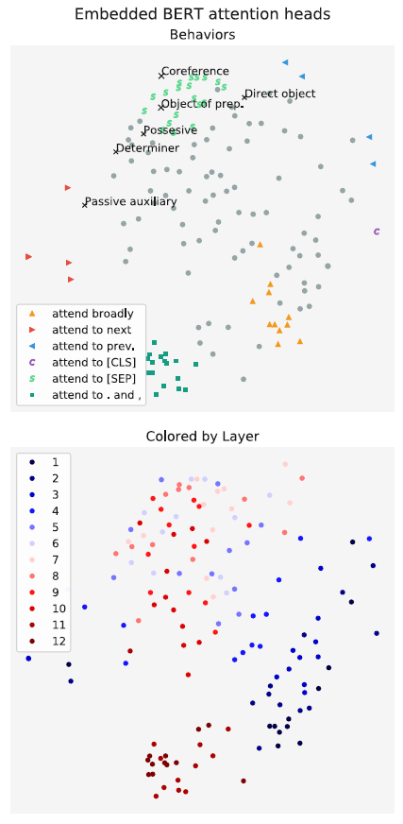
Clustering Attention Heads
Methodology:
Measure distance between 2 heads (Jenson-Shannon Divergences between attention distributions).
Visualize in 2-d using Multidimensional scaling.
Findings:
Heads within the same layer are often close to each other (have similar attention distributions).
Possible reason for this redundancy in BERT’s attention heads:
Attention dropout, which causes some attention weights to be zeroed-out during training.

Slide 12
Positives -
Great starting point to understand attention mechanism and explore the ‘Black box’ nature of large pre-trained models.
Graphs are concise and easy to understand.
Future directions -
1. Extend this to models containing multiple modalities like Visual-BERT, on tasks like image captioning to analyze which part of the image the model attention is focused, while emitting a word token, and in speech models like Listen, Attend and Spell to see where the decoder focuses on while transcription.
2. Model pruning by identifying and removing less important attention heads.
3. Ablation study to see if the relations well-captured by attention are similar for other languages. (Multilingual models)

Slide 13
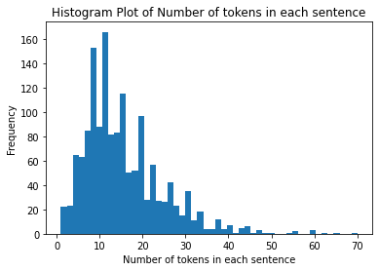
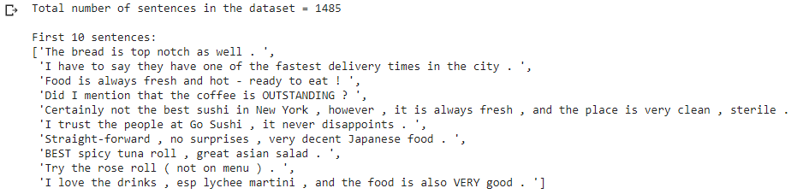
Analysis on a sample dataset
Parsing and Peeking into the sample dataset consisting of restaurant reviews to return a list of input sentences

Slide 14
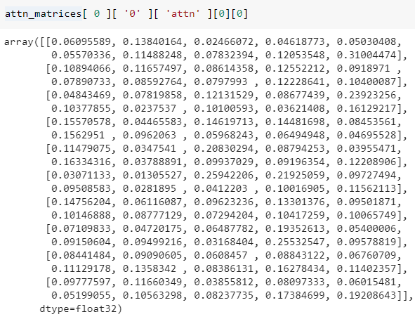

Extract attentions from BERT to create ‘attn_matrices’
'attn_matrices' is a list of 1485 dictionaries, one for each input sentence.
A dictionary in 'attn_matrices' can be accessed by using the following: attn_matrices[sentence_id][ 'sentence_id' ][ 'attn’ ].
This is a list of 12 numpy arrays (corresponding to each transformer layer), where each array is of shape (Number_of_heads, sentence_length, sentence_length)
Figure: Tokens for sentence_0
Attention from each word sums to 1.
Figure: Attention weights for Head 1_1 for sentence_0

Slide 15
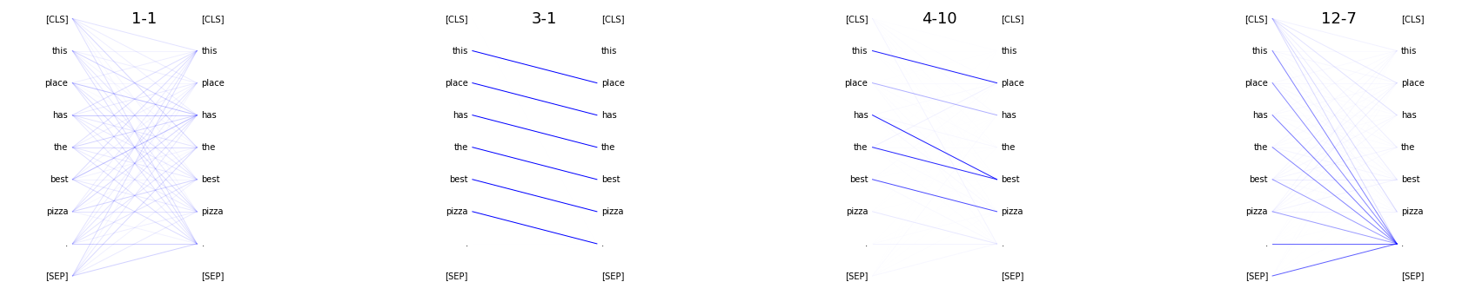
Plotting Attentions
Many tokens attend to the separator tokens. For clear visualization of certain relations, the weights to these tokens are disabled by setting the ‘disable’ parameter = True in the plot_attn function.
Intuitively, a possible explanation for this large attention could be because these tokens act as a ‘no-op’ token for attention heads which capture a specific syntactic-relation.

Slide 16
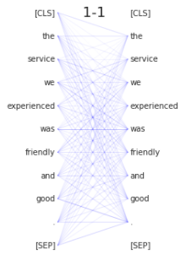
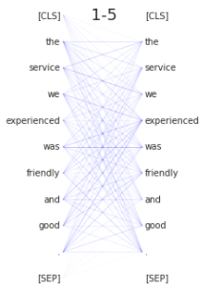
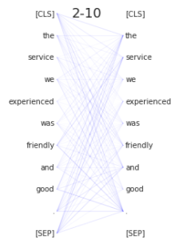
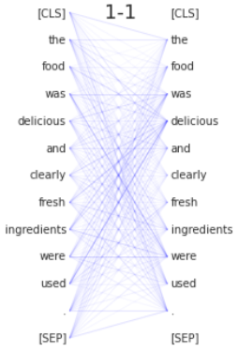
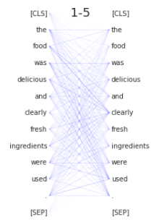
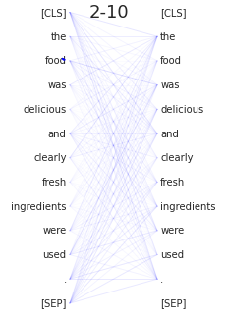
Some attention heads, especially in lower layers Attend Broadly (have high entropy).
‘Sentence_124’- 'The service we experienced was friendly and good . '
‘Sentence_63’- 'The food was delicious and clearly fresh ingredients were used . '
**Note: Broad attention analysis can also be done by finding the heads with large entropy values than others.

Slide 17
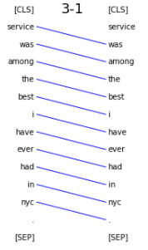
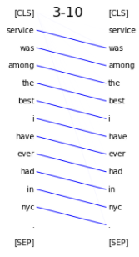
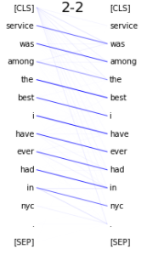
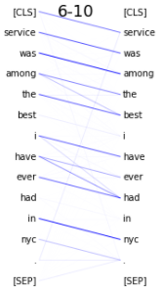
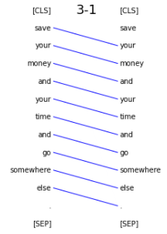
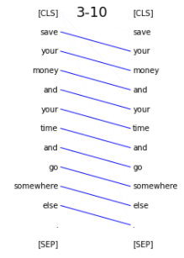
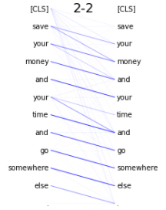
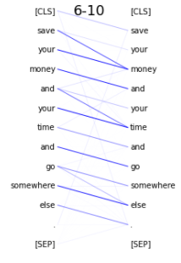
Attend to the next token
‘Sentence_129’- 'Service was among the best I have ever had in NYC . '
‘Sentence_915’ - 'Save your money and your time and go somewhere else . '

Slide 18
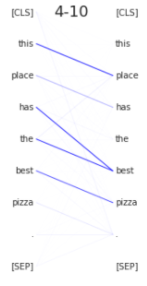
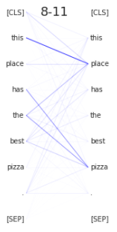
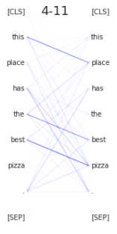
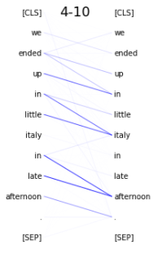
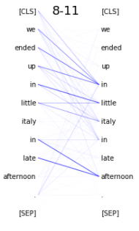
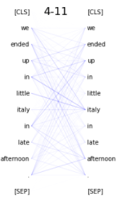
Heads showing ‘amod’ relation. (adjectives attending to the respective nouns)
‘Sentence_185- ‘ This place has the best pizza . '
‘Sentence_26’- 'WE ENDED UP IN LITTLE ITALY IN LATE AFTERNOON . '
Observation:
These heads are often accurate when a noun described by the adjective is the immediate next word following the adjective.
Handling False positives while studying dependency-relations is critical

Slide 19
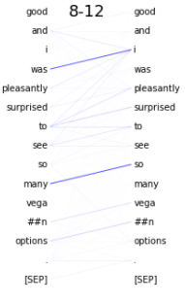
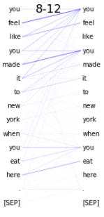
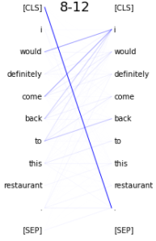
Heads showing ‘nsubj’ (nominal subject) relation.
‘Sentence_81’- 'The food was very good and I was pleasantly surprised to see so many vegan options . '
‘Sentence_611’- 'You feel like you made it to New York when you eat here . ’
‘Sentence_333’- 'I would definitely come back to this restaurant . '

Slide 20
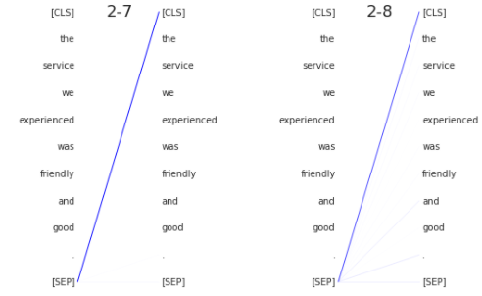
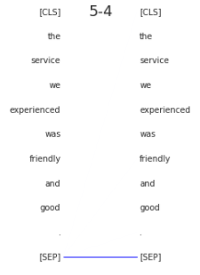
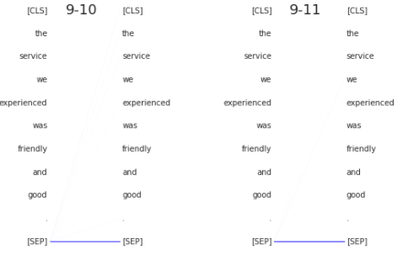
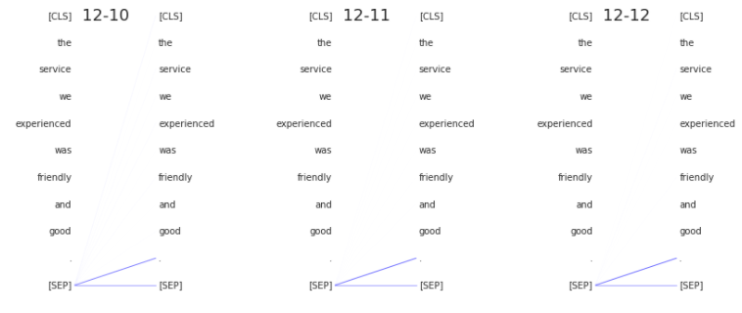
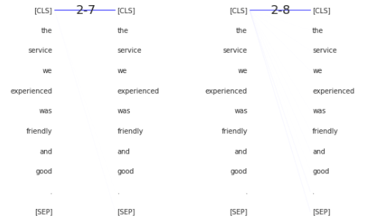
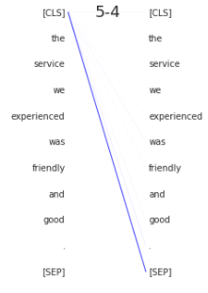
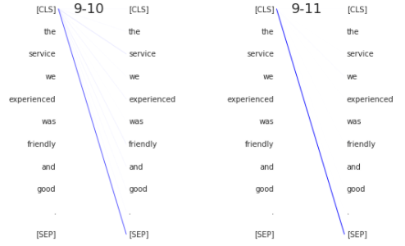
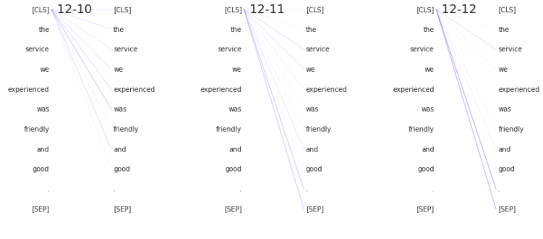
Plotting Attention Heads for ‘[SEP]’ tokens only
In Earlier layers, ‘[SEP]’ tokens attend to ‘[CLS]’
In Layers 5-9 ‘[SEP]’ tokens attend heavily to itself.
Later layers attend to ‘[SEP]’/ periods
Plotting Attention Heads for ‘[CLS]’ tokens only
Similar to ’[SEP]’ tokens, In Earlier layers, ‘[CLS]’ tokens mostly attend to ‘[CLS]’, and in layers 5-9 ‘[CLS]’ tokens attend to ‘[SEP]’.
However, in layers 10-12, ‘[CLS]’ tokens attend broadly, which intuitively makes sense because the ‘[CLS]’ token is used as an aggregated representation of the entire input for sentence classification/ next sentence prediction task.

Slide 21
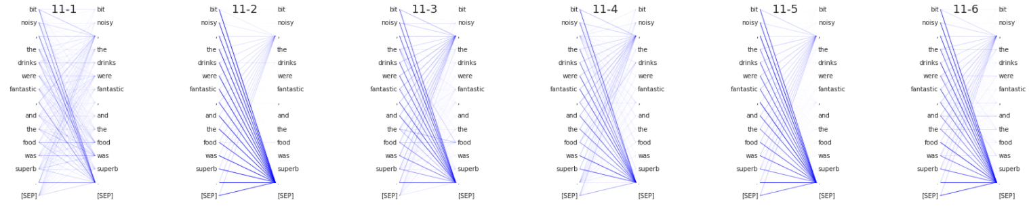

Interesting Heads
Deep Heads attend to periods and commas
‘Sentence_81’- 'While it was large and a bit noisy , the drinks were fantastic , and the food was superb . '
‘Sentence_63’- 'The food was delicious and clearly fresh ingredients were used . '

Slide 22






Interesting Heads
Heads attending to previous tokens - ‘Sentence_63’- 'The food was delicious and clearly fresh ingredients were used . '
Coreference Resolution - ‘Sentence_460’- ' It first came well done , and I politely sent it back . '
Coreference links are usually longer than syntactic dependencies
Head 5_4 performs well on CONLL-2012 on antecedent selection task.
Performs good with nominal mentions perhaps because it is capable with fuzzy matching of synonyms

Slide 23


Head clustering plots in 2D:
BERT Attention Heads by Layer
BERT Attention Heads (Heads which showed the labelled behaviors)

Slide 24
Thank You

